Slide 1


There is Hope in
Jesus Christ
1 Peter 1:6-7, Romans 5:3-5, 1 John 3:2-3
Pastor Rod Lago

Slide 2
1 John 3:2-3 (NIV)
2 Dear friends, now we are children of God, and what we will be has not yet been made known. But we know that when Christ appears,[a] we shall be like him, for we shall see him as he is. 3 All who have this hope in him purify themselves, just as he is pure.

Slide 3
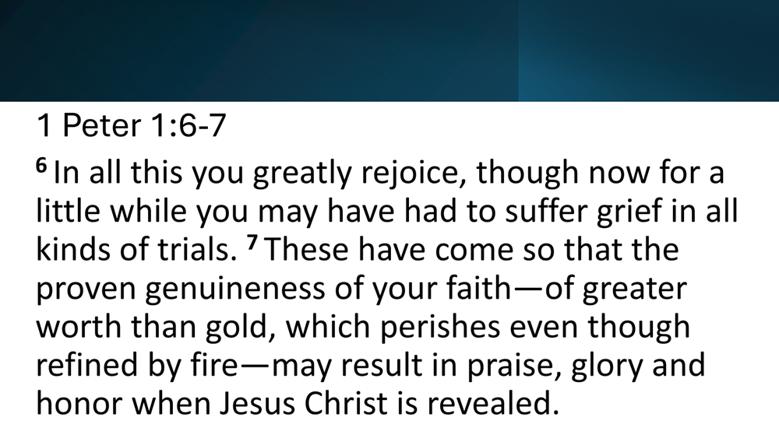

Slide 4
Romans 12:12 (NIV)
12 rejoice in hope be patient in tribulations, be constant in Prayer.
Romans 5:3-5 (NIV)
3 Not only so, but we[a] also glory in our sufferings, because we know that suffering produces perseverance; 4 perseverance, character; and character, hope. joyful in hope, patient in affliction, faithful in prayer. 5 And hope does not put us to shame, because God’s love has been poured out into our hearts through the Holy Spirit, who has been given to us.

Slide 5
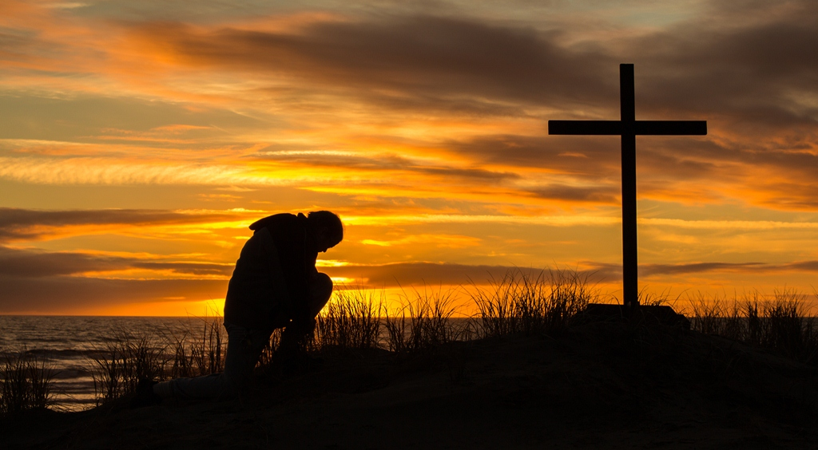
I. HOPE gives us Courage during Adversities. 1 Peter 1:6-7

Slide 6
1 Peter 1:6-7
⁶ In all this you greatly rejoice, though now for a little while you may have had to suffer grief in all kinds of trials. ⁷ These have come so that the proven genuineness of your faith—of greater worth than gold, which perishes even though refined by fire—may result in praise, glory and honor when Jesus Christ is revealed.

Slide 7
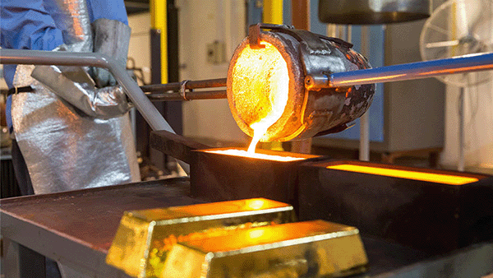
Notes:
HOPE gives us Courage during Trials…
HOPE gives us Courage to Hold on…

Slide 8
LIFE APPLICATION:
HOPE will give us strength to make forward and will make us Courageous during life’s greatest battle.

Slide 9

II. HOPE drives you to God for Answers.
Romans 5:3-5

Slide 10
Romans 5:3-5
³ Not only so, but we^{[a]} also glory in our sufferings, because we know that suffering produces perseverance; ⁴ perseverance, character; and character, hope. ⁵ And hope does not put us to shame, because God’s love has been poured out into our hearts through the Holy Spirit, who has been given to us.

Slide 11
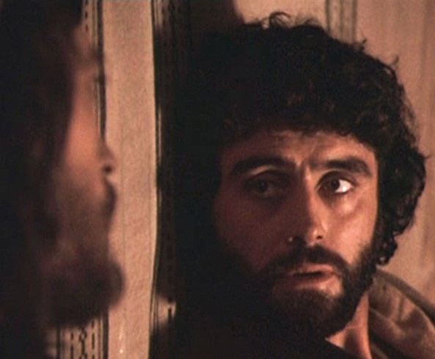
Life of Judas
Notes:
Ex: LIFE OF JUDAS ISCARIOT…
His life was a perfect example of what we called “WASTED OPPORTUNITY” nasa harapan niya na yung GREATEST HOPE ng buhay niya pero mas pinili niya parin ang pera thinking about that “MONEY WILL SATISFY HIS EMPTY SOUL” But in the end “MONEY DISSAPOINTED HIM”

Slide 12
LIFE APPLICATION:
THIS WORLD WILL DISSAPOINT US BUT ALWAYS REMEMBER THAT JESUS CHRIST WILL NEVER DISSAPOINT YOU!
Notes:
So tonight, if you are looking an Answers to all of your life questions then the answer is JESUS!!!
Kung sinasabi mo ngayon na nasubukan muna lahat, nalapitan muna lahat…. Bakit hindi mo subukan lumapit sa Kaniya, tumawag sa Kaniya at nakakasigurado ka kung si JESUS ang magiging Pag Asa ng iyong buhay hinding hindi ka MADIDISAPOINT!!!!

Slide 13

III. HOPE PREPARES OUR LIFE FOR HIS RETURN.
1 John 3:2-3

Slide 14
1 John 3:2-3
² Dear friends, now we are children of God, and what we will be has not yet been made known. But we know that when Christ appears,^{[a]} we shall be like him, for we shall see him as he is. ³ All who have this hope in him purify themselves, just as he is pure.

Slide 15
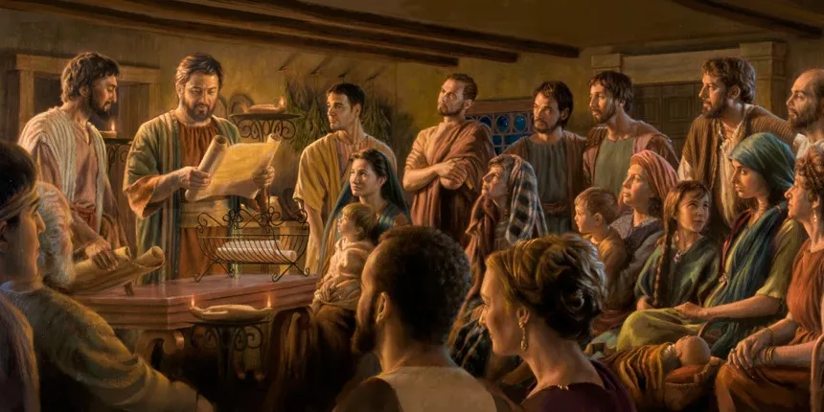
Example : early believers
Notes:
The life of early believers was not only a men and women of faith, but also they were the people of Hope…
They faced all kinds of Persecutions, Rejections, Trials, even great Problems in life but their never lose HOPES…
THEIR LIVES BECAME A GOOD EXAMPLE FOR ALL THE COMMUNITY OF THE BELIEVERS AND BECAME LIVING INSPIRATION THAT BRINGS HOPE FOR THE HOPELESS PEOPLE.

Slide 16
LIFE APPLICATION:
HOPE will sustain us to follow Jesus Christ no matter what the cost because this “HOPE” is now Living inside us, therefore let us put our HOPE to the ONE Who is UNSHAKEABLE,
UNCHANGEABLE and INDESTRUCTIBLE.
Notes:
So tonight, if you are looking an Answers to all of your life questions then the answer is JESUS!!!
Kung sinasabi mo ngayon na nasubukan muna lahat, nalapitan muna lahat…. Bakit hindi mo subukan lumapit sa Kaniya, tumawag sa Kaniya at nakakasigurado ka kung si JESUS ang magiging Pag Asa ng iyong buhay hinding hindi ka MADIDISAPOINT!!!!

